Slide 1
COLLECTIONS
(An easy way to manage Objects)

Slide 2
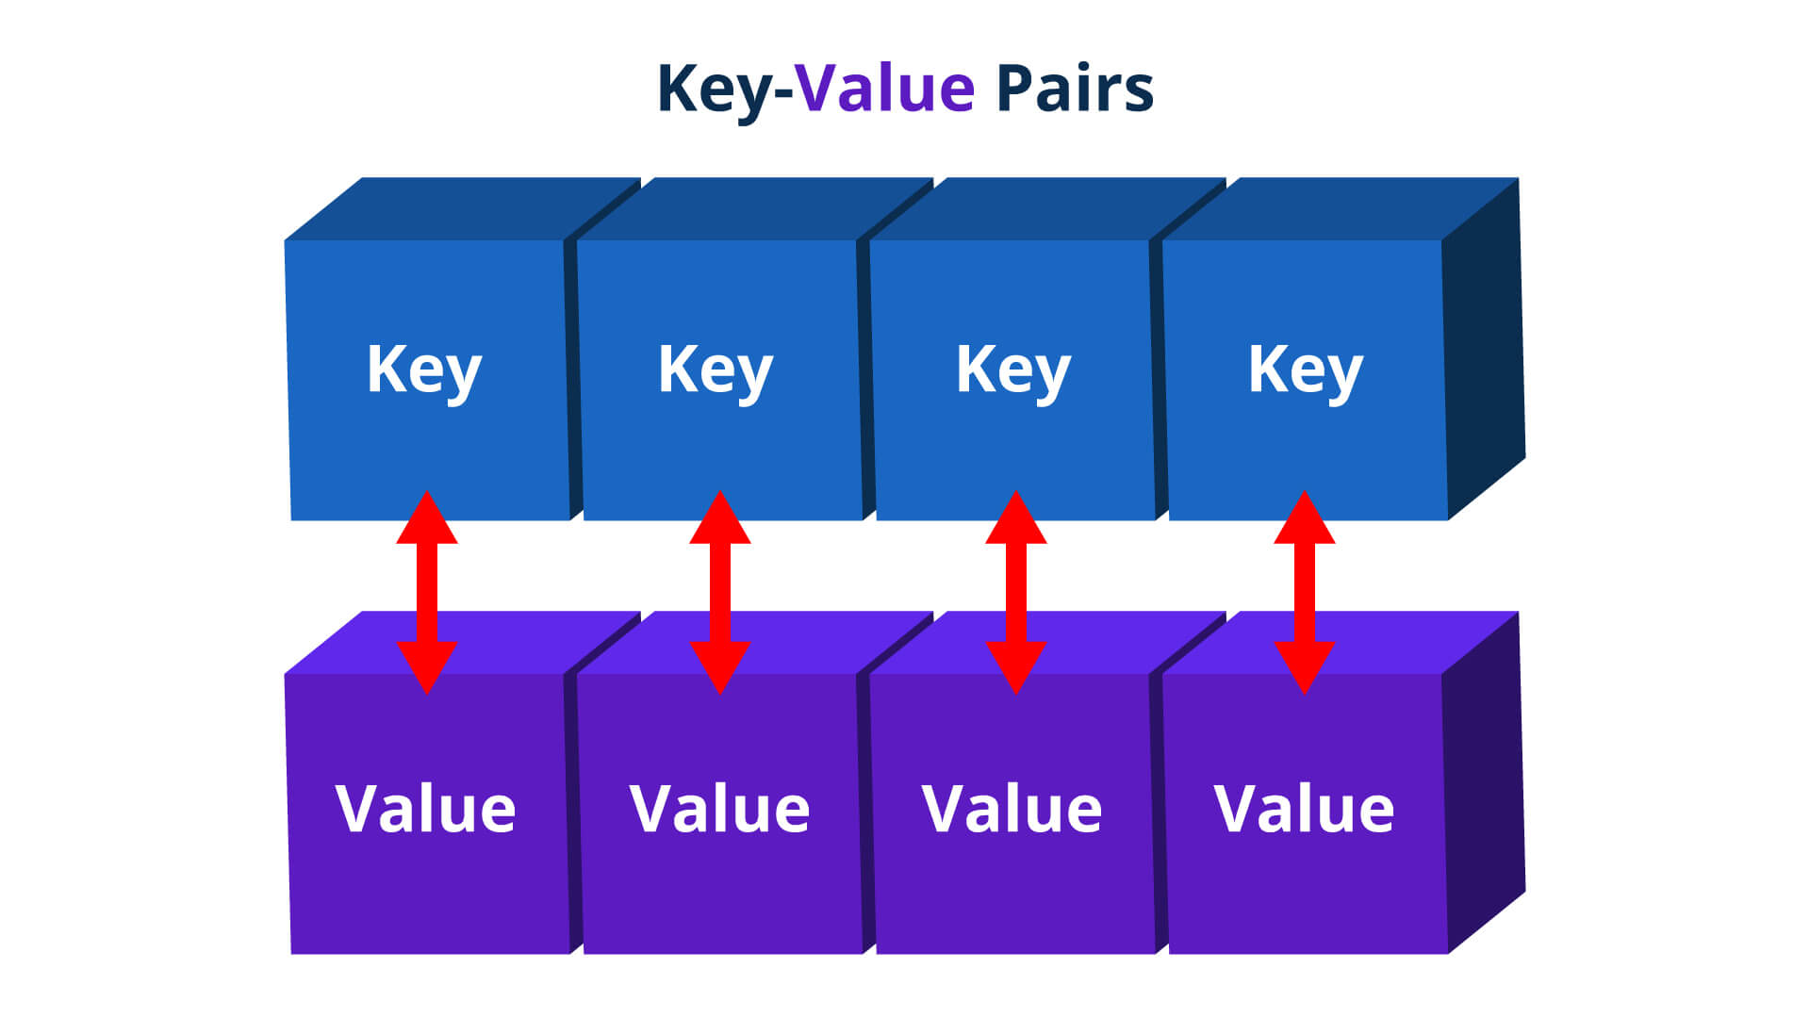
The Map Interface
It is not the child interface of Collection interface but has methods similar to Collection
A Map is an object that stores data in pairs , called key-value pair.

Slide 3
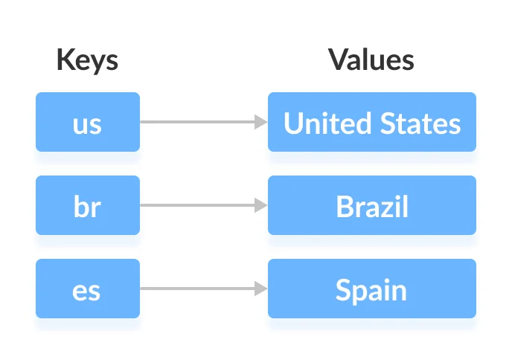
Example Of Key-value Pair

Slide 4
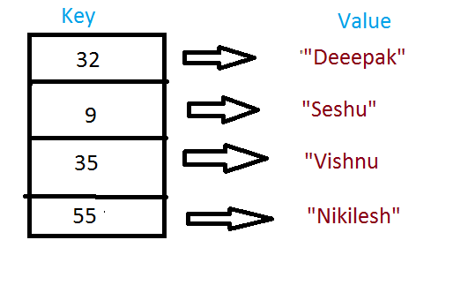
Example Of Key-value Pair

Slide 5
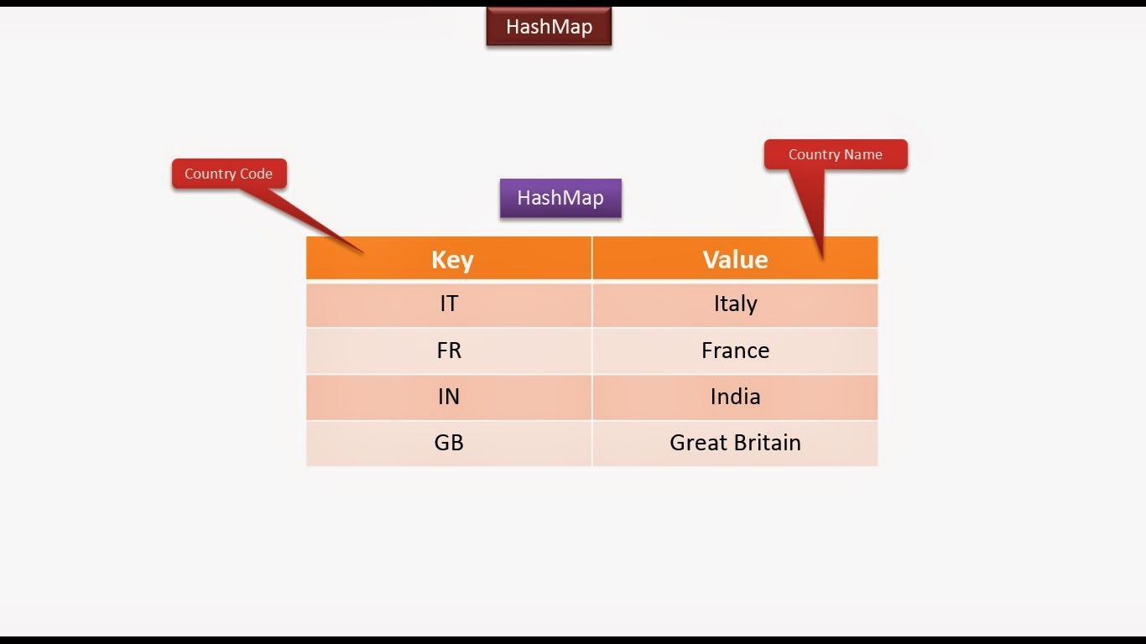
Example Of Key-value Pair

Slide 6
How values are stored in Map ?
1.The keys in a Map have to be unique.
2.Each key-value pair is saved in the Map is saved as an object of type Entry

Slide 7
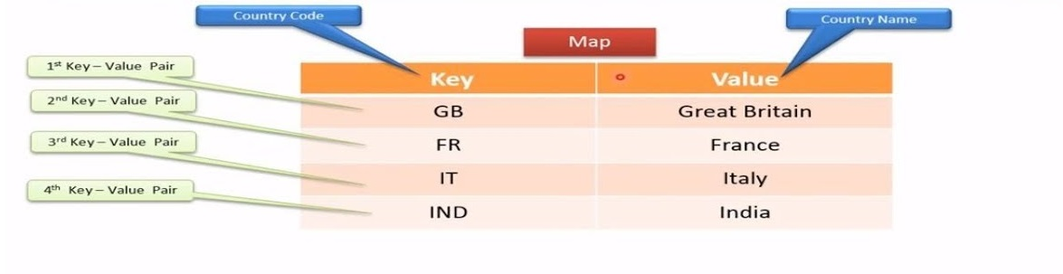
How values are stored in Map ?

Slide 8
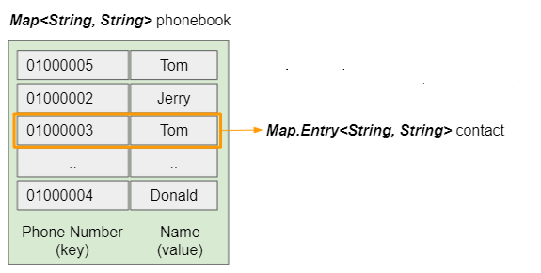
How values are stored in Map ?

Slide 9
Important Methods Of Map
Object put(Object k, Object v)
Puts an entry in the invoking map, overwriting any previous value associated with the key.
The key and value are k and v, respectively.
Returns null if the key did not already exist , otherwise it returns the previous value linked to the key

Slide 10
Important Methods Of Map
Object get(Object k)
Returns the value associated with the key k
If the key is not found , it returns null.

Slide 11
Important Methods Of Map
void clear( )
Removes all key/value pairs from the invoking map.

Slide 12
Important Methods Of Map
boolean containsKey(Object k)
Returns true if the invoking map contains k as a key.
Otherwise, returns false.
boolean containsValue(Object v)
Returns true if the map contains v as a value.
Otherwise, returns false

Slide 13
Important Methods Of Map
boolean isEmpty( )
Returns true if the invoking map is empty.
Otherwise, returns false.
int size( )
Returns the number of key/value pairs in the map.

Slide 14
Important Methods Of Map
Object remove(Object k)
Removes the entry whose key equals k
Returns the previous value associated with the specified key,
Otherwise it returns null if there was no mapping for the key

Slide 15
Important Methods Of Map
Collection values( )
Returns a Collection containing the values in the map.

Slide 16
Important Methods Of Map
Set keySet( )
Returns a Set that contains the keys in the invoking map.

Slide 17
Important Methods Of Map
Set entrySet( )
Returns a Set that contains the entries in the map.
The set contains objects of type Map.Entry.

Slide 18
Important Methods Of Entry
Object getKey( )
Returns the key corresponding to this Entry object

Slide 19
Important Methods Of Entry
Object getValue( )
Returns the value corresponding to this Entry object

Slide 20
Important Methods Of Entry
Object setValue(Object)
Replaces the old value corresponding to this entry with the specified value
Returns the old value

Slide 21
Implementation Classes
The Collections Framework provides 2 very important Map implementation:
1 - HashMap
2 - TreeMap
HashMap:
The HashMap is a class which is used to perform some basic operations such as inserting, deleting, and locating elements in a Map
TreeMap:
The TreeMap implementation is useful when we need to traverse the keys from a collection in a sorted manner. The elements added to a TreeMap must be sortable in order to work properly.

Slide 22
The HashMap class
Internally uses HashTable to store the data.
Stores data as key-value pairs
It contains only unique elements.
It is not an ordered collection.

Slide 23
The HashMap class
It neither does any kind of sorting to the stored keys and Values.
Ensures retrieval of the object on constant time i.e. O(1)

Slide 24
The HashMap Constructors
HashMap( )
This constructs an empty HashMap with the default initial capacity (16) and the default load factor (0.75).
HashMap(int initialCapacity)
Constructs an empty HashMap with the specified initial
capacity and the default load factor (0.75).

Slide 25
The HashMap Constructors
HashMap(int initalCapacity,float loadFactor )
Constructs an empty HashMap with the specified initial capacity and load factor.
HashMap(Map m)
Constructs a new HashMap with the same mappings as
the specified Map.

Slide 26
Exercise 9
WAP to store the Names and Phone Numbers of following
members of TEAM SCA . Now retrieve these values and
display them
Name | Phone
Sachin | 9826086245
Aftaab | 7992202926
Arif | 8982585147
Mohnish | 8962336876

Slide 27
Adding Data In HashMap
Map<String,Long> teamSca = new HashMap<>();
teamSca.put("Sachin", 9826086245L);
teamSca.put("Aftaab",7992202926L );
teamSca.put("Arif", 8982585147L);
teamSca.put("Mohnish", 8962336876L);

Slide 28
Retrieving Data From HashMap
Retrieval of data from HashSet can be done in 4 ways:
Retrieving all values together
Retrieving only keys
Retrieving only values
Retrieving key-value pairs

Slide 29
Retrieving All Values Together
For this we simply have to pass the name of HashSet reference to the method println()
Example:
Map<String,Long> teamSca = new HashMap<>();
teamSca.put("Sachin", 9826086245L);
teamSca.put("Aftaab",7992202926L );
teamSca.put("Arif", 8982585147L);
teamSca.put("Mohnish", 8962336876L);
System.out.println(teamSca);
Output:
{Mohnish=8962336876, Aftaab=7992202926, Sachin=9826086245, Arif=8982585147}

Slide 30
Retrieving Only The Keys
For this we have to do 2 things:
1. Call the method keySet() which returns a Set of keys of the HashMap
2. Use an Iterator over this Set
Example:
Map<String,Long> teamSca = new HashMap<>();
.......
Set s=teamSca.keySet();
Iterator <String> it=s.iterator();
while(it.hasNext())
{
String key=it.next();
System.out.println(key);
}
Output:
Mohnish
Aftaab
Sachin
Arif

Slide 31
Retrieving Only The Values
For this we have to do 2 things:
1. Call the method values() which returns a Collection of values of the HashMap
2. Use an Iterator over this Collection
Example:
Map<String,Long> teamSca = new HashMap<>();
.......
Collection c=teamSca.values();
Iterator <Long> it=c.iterator();
while(it.hasNext())
{
Long value=it.next();
System.out.println(value);
}
Output:
8962336876
7992202926
9826086245
8982585147

Slide 32
Retrieving Key-Value Pairs
For this we have to do 2 things:
Call the method entrySet( ) which returns a Set of all the data in the HashMap
Each element in this Set is an object of type Entry
Entry is an inner interface of Map and has 2 methods called getKey() and getValue()
So we will have to get an Iterator over this Entry

Slide 33
Retrieving Key-Value Pairs
Example:
Map<String,Long> teamSca = new HashMap<>();
.......
Set e=teamSca.entrySet();
Iterator it=e.iterator();
while(it.hasNext())
{
Entry et=(Map.Entry)it.next();
System.out.println(et.getKey()+","+et.getValue());
}
Output:
Mohnish,8962336876,
Aftaab,7992202926,
Sachin,9826086245
Arif,8982585147

Slide 34
Checking whether a value exists or not
To get the Value from HashMap object we use the method:
boolean containsValue(value)
This method returns true if list contains the specified Value otherwise returns false.

Slide 35
Program
import java.util.*; public class HashMapDemo{ public static void main(String args[]) { Map<String,Long> teamSca = new HashMap<>();
teamSca.put("Sachin", 9826086245L);
teamSca.put("Aftaab",7992202926L );
teamSca.put("Arif", 8982585147L);
teamSca.put("Mohnish", 8962336876L);
boolean bool = teamSca.containsKey(“Sachin"); System.out.println(“Does Sachin is exists in HashMap : " + bool); } }
Output:
Does Sachin is exists in HashMap : true

Slide 36
Using remove( ) and size( )
To get total number of elements in a HashMap we use the method:
public int size()
To remove a particular key from the HashMap we use the method:
public Object remove(key)
This method removes the specified entry from the HashMap whose key is passed as argument and returns the deleted value

Slide 37
import java.util.*;
public class HashMapDemo {
public static void main(String args[]) {
Map<String,Long> teamSca = new HashMap<>();
teamSca.put("Sachin", 9826086245L);
teamSca.put("Aftaab",7992202926L );
teamSca.put("Arif", 8982585147L);
teamSca.put("Mohnish", 8962336876L);
System.out.println("The size of HashMap is : " + hm.size());
hm.remove(“Arif");
System.out.println("The size of HashMap after alteration is : "
+ hm.size());
}
}

Slide 38
Output
Output:
The size of HashMap is : 4
The size of HashMap after alteration is : 3

Slide 39
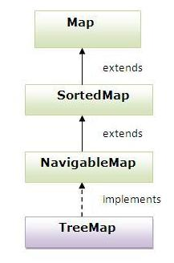
The TreeMap class
TreeMap class implements NavigableMap , SortedMap and Map interfaces.

Slide 40
The TreeMap class
1.The TreeMap class implements the Map interface by using a tree.
2. A TreeMap provides an efficient means of storing key/value pairs in sorted order
3. Doesn’t store duplicates

Slide 41
Example
import java.util.*;
class TreeMapDemo {
public static void main(String args[]) {
Map<String,Long> teamSca = new TreeMap<>();
teamSca.put("Sachin", 9826086245L);
teamSca.put("Aftaab",7992202926L );
teamSca.put("Arif", 8982585147L);
teamSca.put("Mohnish", 8962336876L);
System.out.println(teamSca);
}
}

Slide 42
Output
{Aftaab=7992202926, Arif=8982585147, Mohnish=8962336876, Sachin=9826086245}

Slide 43
Example
import java.util.*;
class TreeMapDemo {
public static void main(String args[]) {
Map<String,Long> teamSca = new TreeMap<>();
teamSca.put("Sachin", 9826086245L);
teamSca.put("Aftaab",7992202926L );
teamSca.put("Arif", 8982585147L);
teamSca.put("Mohnish", 8962336876L);

Slide 44
Set e=teamSca.entrySet();
Iterator it=e.iterator();
while(it.hasNext())
{
Entry et=(Map.Entry)it.next();
System.out.println(et.getKey()+","+et.getValue());
}
}
}

Slide 45
Output
Aftaab,7992202926,
Arif,8982585147
Mohnish,8962336876
Sachin,9826086245

Slide 46
Exercise 10
A Bank maintains bank account of it’s users in the
database. When you visit the bank and tell your account
number to the teller , he fetches your account details.
Create a collection and maintain bank accounts in that.
There should be a single entry for one account number
We should be able to fetch the account details when an account number is supplied to the collection.

Slide 47
The program should have 3 classes:
Account : should contain 3 data members called accountNumber, name and balance . Also provide appropriate constructor and other important methods
Bank: should contain a HashMap of Account . Also provide 5 methods called :
addAccount( )
getAccount()
removeAccount()
getCount()
getAllAccounts( )
UseBank: This will be our driver class . It will contain code to do the following:
Create 4 Account objects and add them to the Bank .
Display their details.
Now fetch the details of a particular account by passing it’s account number
Remove an account by passing it’s account number
Display total number of Accounts

Slide 48
Exercise 11
Make changes in the Bank Application so that whenever we
display the records , they always get displayed in sorted
order of account id

Slide 49
HashMap v/s TreeMap
HashMap is useful when we need to access the map without considering how they are added to the map (means, unordered lookup of values using their keys).
HashMap doesn’t allow duplicated entries.
TreeMap stores the elements in a tree.
TreeMap allows us to retrieve the elements in some sorted order .
So we can say that TreeMap is slower than HashMap

